Slide 1
Distributed Cache

Slide 2
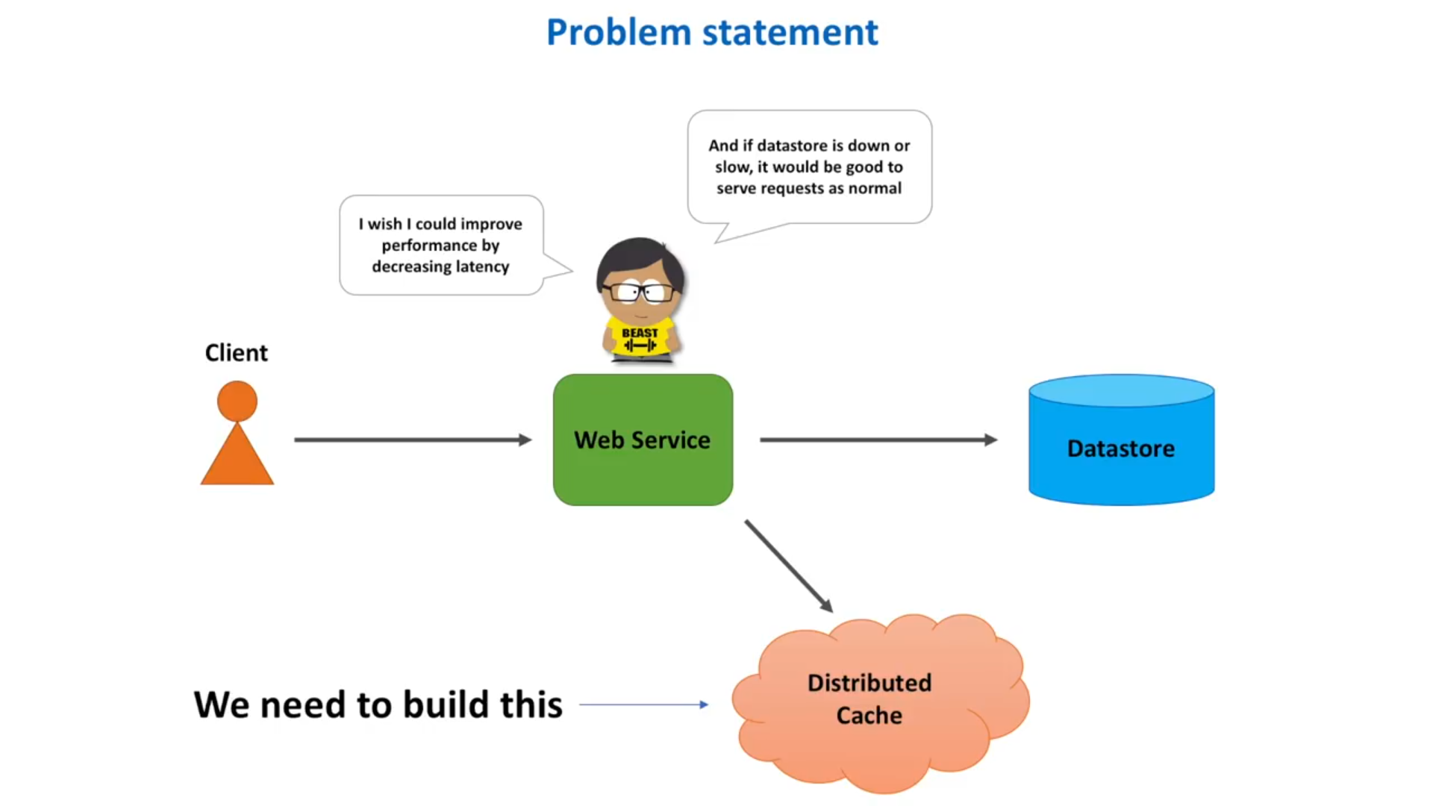
Problem Statement

Slide 3
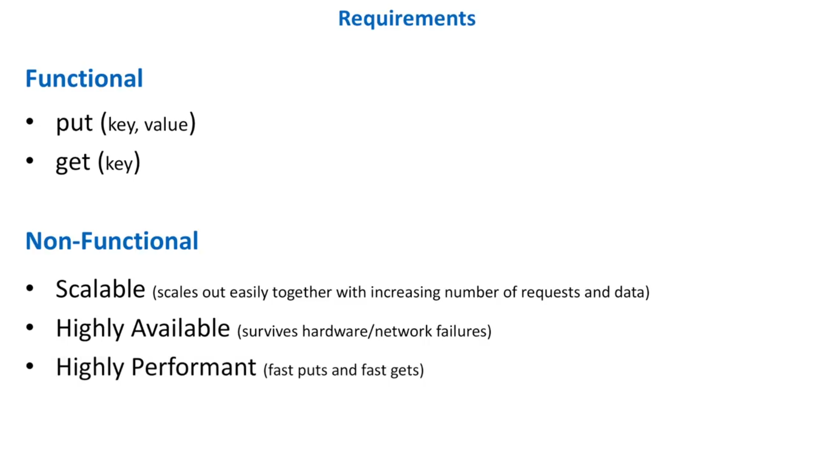
Requirements

Slide 4
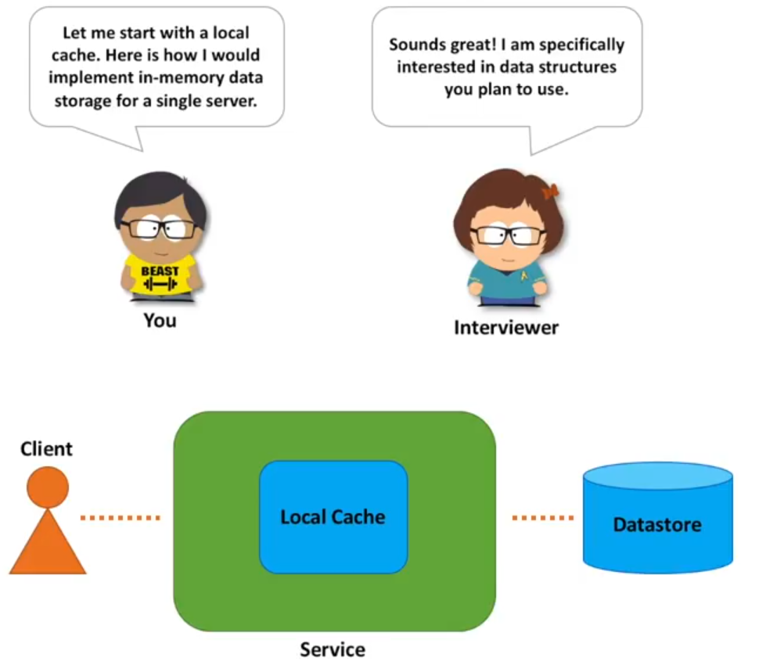
One Step : Local Cache

Slide 5
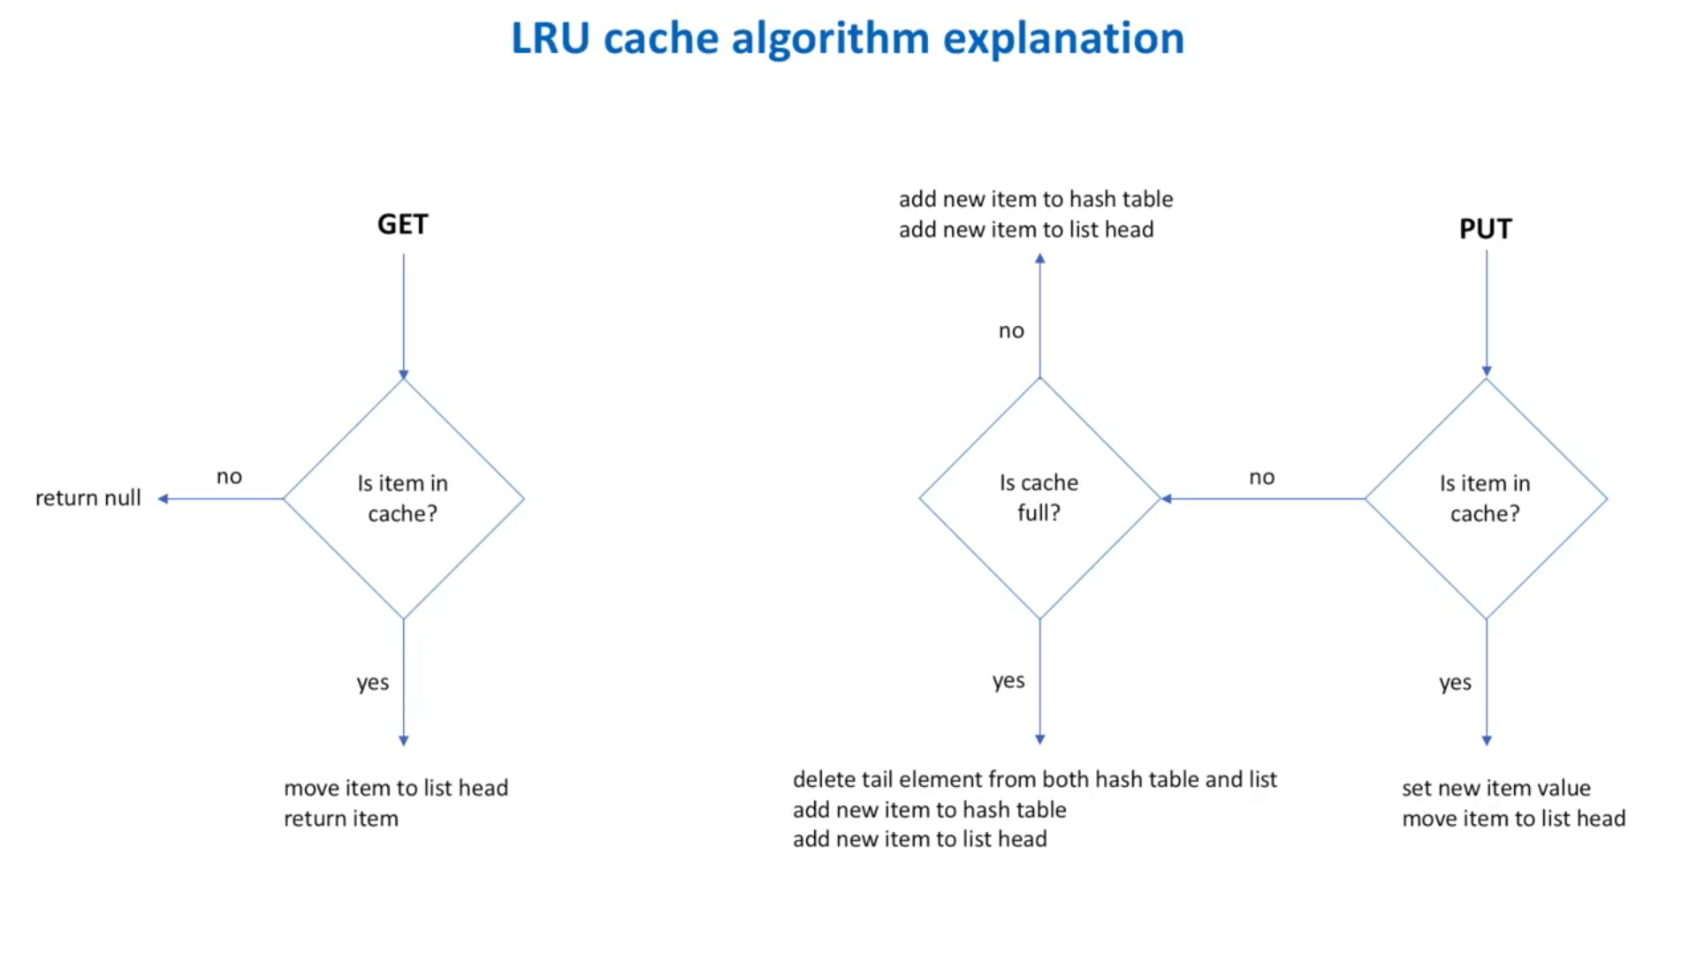

Slide 6
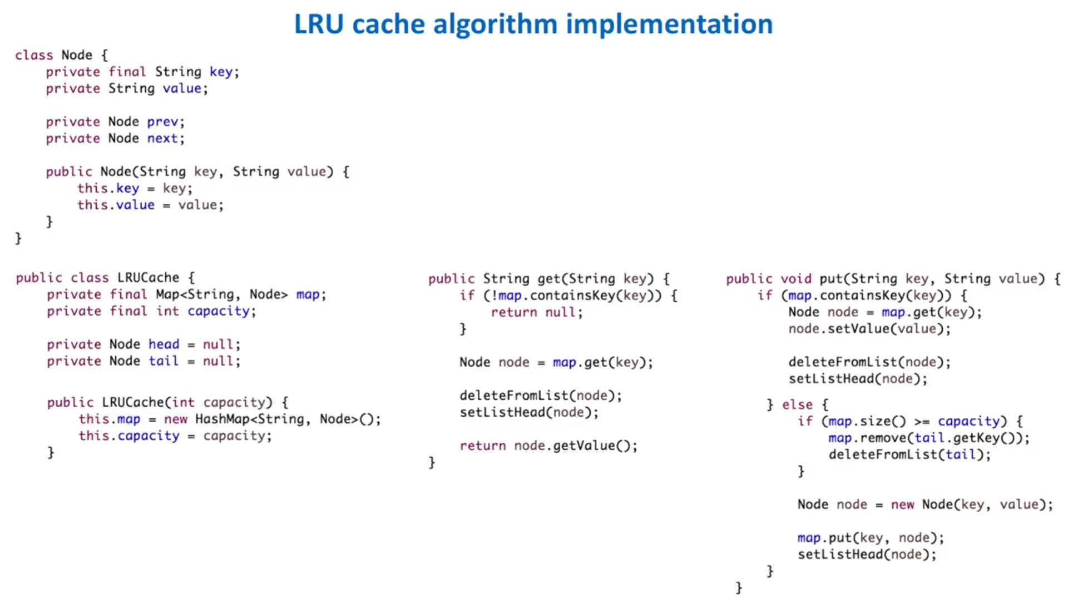

Slide 7
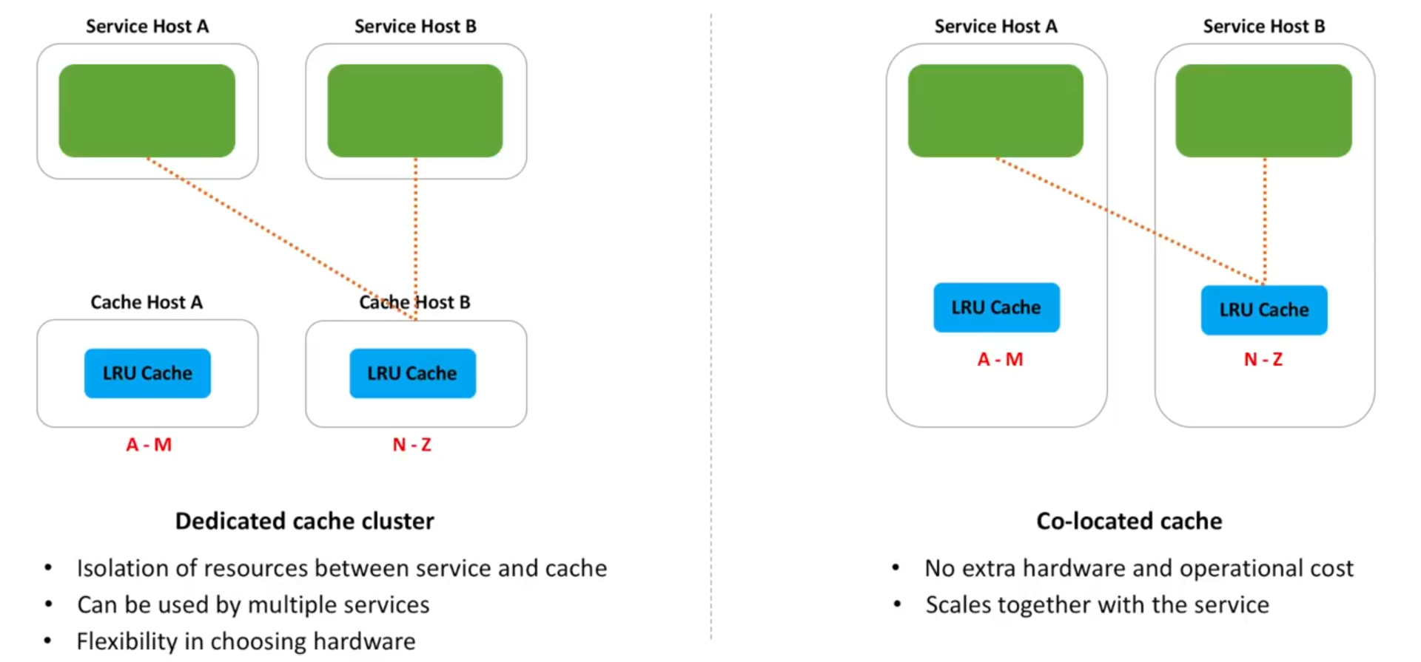
Distributed Approach 1: Sharding Cache cluster
Cache client process running in each service host communicate with cache hosts using UDP/TCP.

Slide 8
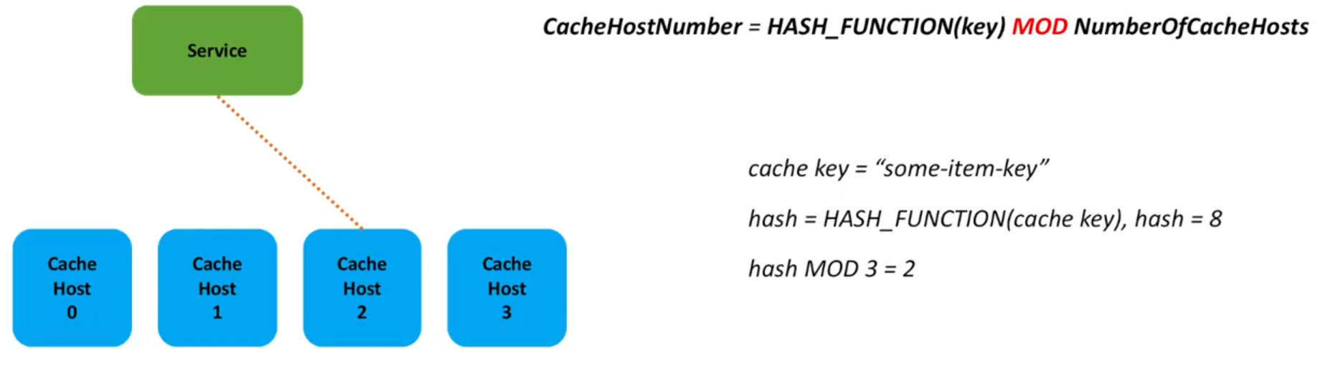
Choosing a cache host : Naive Approach

Slide 9
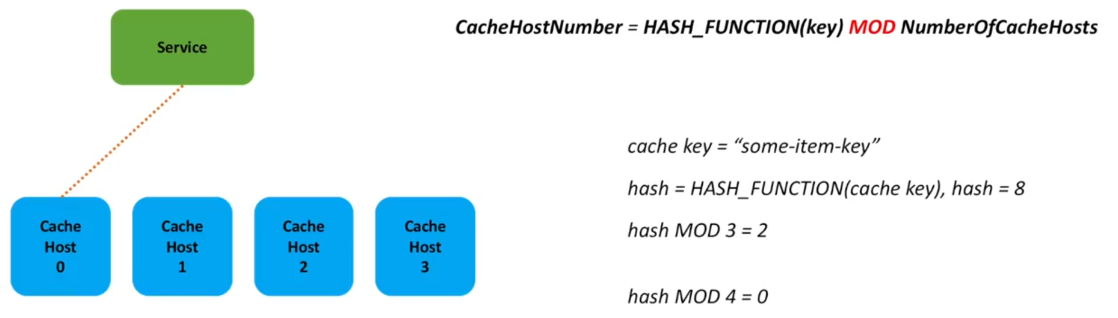
Choosing a cache host: Naive Approach Problem
When the number of cache hosts increases or decreases, the hash MOD N produces different results resulting in
high rates of cache miss.

Slide 10
Choosing a cache host: Consistent Hashing
Cache clients use consistent hashing to pick a shard for storing/retrieving a key.

Slide 11
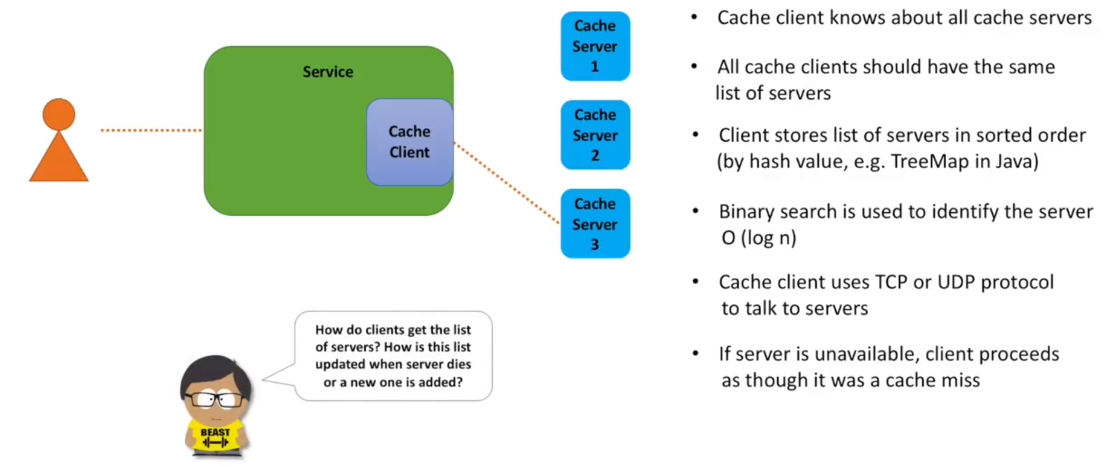
Cache Client

Slide 12
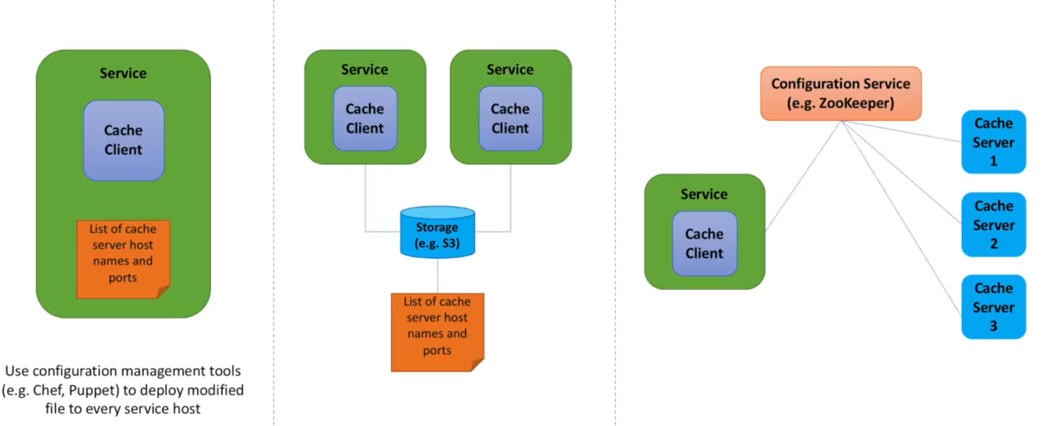
Maintaining a list of servers

Slide 13
To store more data in memory we partition data into shards and put each shard into its own server.
Every cache client knows about every cache shard. Cache client uses consistent hashing to store/retrieve a particular cache key.
Is the system fast, available and scalable?
  fast - Yes. LRU implementation uses O(1) time. Cache client picks cache server in O(log n) time. Connection between cache client and cache server is done using TCP/UDP which is also fast.
  scalability - Yes. We can easily create more shards.
  highly available - No. In the current design if a shard dies or becomes unavailable due to network partition, the data in the shard is lost and all request to that shard will result in a cache miss until keys are rehashed.

Slide 14
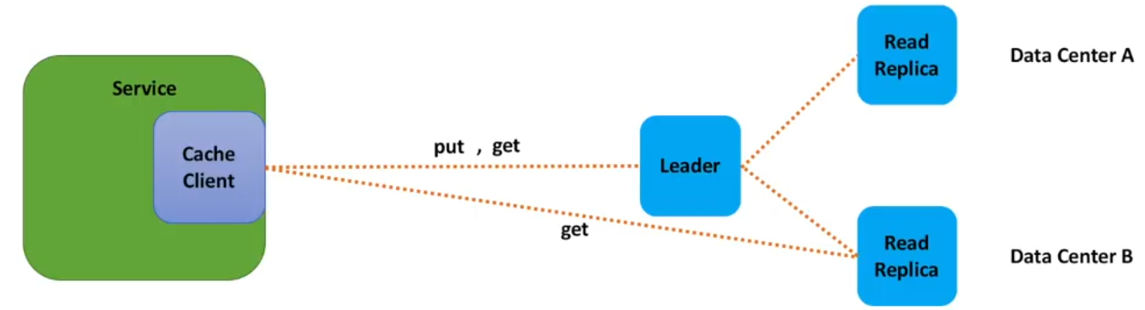
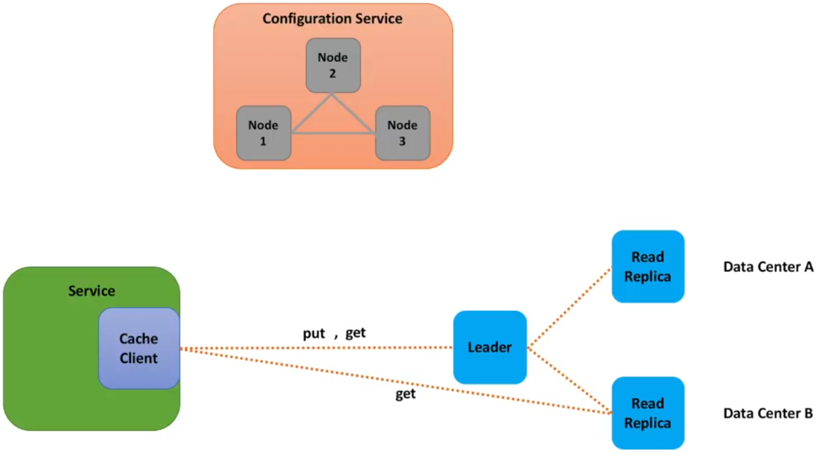
Achieving High Availability
High availability can be achieved using read replicas.
How leaders are elected?
option1: rely on a separate component
option2: implement election in cache cluster.
Candidates - Zookeeper, Redis sentinal

Slide 15
The data between the leader and followers is replicated asynchronously.
To achieve less latency, we dont want to wait until the leader has written the data to followers.
This behaviour leads to eventual consistency.
The leader may die before writing the data to the followers. The data in this case will be lost.
This is acceptable.

Slide 16
What else?
Consistency - The system built till now has eventual consistency. To achieve strong consistency we need to have synchronous copy from leader to followers.
Data Expiration - LRU automatically deletes items when the cache is full. But if the cache is not full then some items may sit in the cache for long time and become stale. To handle this case we might use TTL for each entry. There are 2 ways on how we purge the cache-
  When a client tries to access an expired entry then we delete the entry and return a not found status.
  A separate Cleanup service can run periodically to remove expired links from our storage and cache. This service should be very lightweight and can be scheduled to run only when the user traffic is expected to be low.
  As there might be billions of entries in cache, we cannot simply iterate over all the items. Some kind of probabilistic algorithms are used.

Slide 17
Local and remote cache - When a key is not present in local cache, then a call to the distributed cache is made. We can create a local cache in the cache client itself.
Security - Caches are optimized for fast lookups and not for security. Caches are usually accessed by trusted clients inside trusted environments.
Monitoring and logging - Metrics such as number of faults while calling the cache, latency, number of hits and misses, cpu and memory utilization of cache host, network i/o. For logging we can capture who and when accessed the cache, what was the key and the return status code.
Cache client - The cache client should be simple and dumb. We can introduce a cache proxy that will sit between a cache client and cache cluster to pick a shard. ex - Twemproxy. Another approach can be - cache client randomly calls a cache shard. The cache server using some algorithm redirects the request to the destination shard. ex-Redis cluster.

Slide 18
